Slide 1
Predicting income level from census data
Kevin Tran
Springboard Data Science Career Track
Capstone 1

Slide 2
Problem Statement
Objective
Predict whether an individual earns over $50,000 a year based on census demographic attributes (1994 Census UCI Repository Dataset)
Applications
Targeted customer acquisition, marketing, and outreach
Pricing by customer segment
Insight on customer base

Slide 3
Agenda
Data Wrangling
Data Story
Inferential Statistics
Machine Learning
Future Work

Slide 4
Data wrangling removes problematic records and simplifies dataset
Issues Addressed
Steps Taken
Missing data
Records with missing data removed
Small overall percentage of data set (<10% of data)
Unnecessary Features
Redundant features removed
‘fnlwgt’ column not relevant to analysis
‘education-num’ column redundant with education level
Extraneous categories
Similar categories within features condensed
Workclass: Self-employed (self-emp-not-inc, self-emp-inc), Not paid (without-pay, never-worked)
Education: Below HS (12th, 11th, 10th, 9th, 7th-8th, 5th-6th, 1st-4th, Preschool), HS Grad (HS-Grad, some college), Associates (Assoc-acdm, Assoc-voc)
Marital-Status: Not married (divorced, separated, married-spouse-absent)

Slide 5
Agenda
Data Wrangling
Data Story
Inferential Statistics
Machine Learning
Future Work

Slide 6
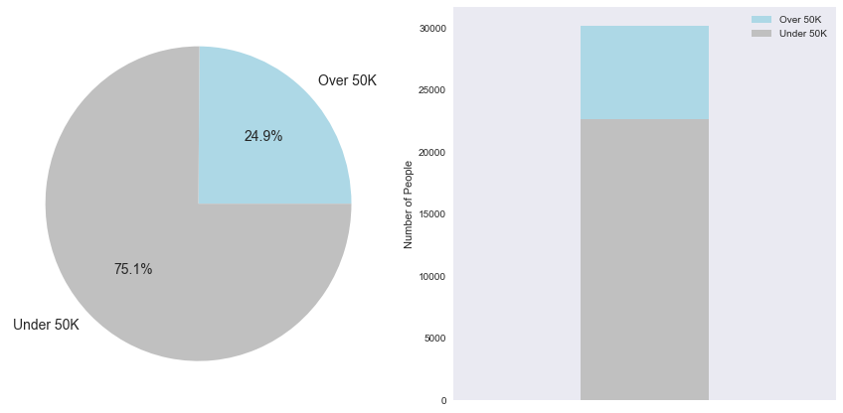
Preliminary data exploration reveals key insights for each feature
Feature | Insight
Total Dataset | 75.1% of dataset earns <$50K
Education level | 72% accuracy predicting by education <$50K has more HS-grad and fewer higher education
Marital Status | >90% of unmarried individuals earn <$50K
Sex | 88.6% of females earn <$50K 68.6% of males earn <$50K Half as many females as males in dataset.

Slide 7
Agenda
Data Wrangling
Data Story
Inferential Statistics
Machine Learning
Future Work

Slide 8
Important features were verified using statistical tests
Chi-square testing
Using chi-square testing, education level, marital status, relationship, race, and sex were determined to be significant factors
The null hypothesis that the categories above were distributed similarly in the <$50K and >$50K groups was rejected at p = <10⁻⁴⁰
Difference in mean
The difference in mean age and hours worked between the two groups was significant. The >$50K group was older and worked more hours on average
The null hypothesis that there was no difference in mean age and hours worked was rejected at p = <10⁻⁴⁰

Slide 9
Agenda
Data Wrangling
Data Story
Inferential Statistics
Machine Learning
Future Work

Slide 10
Overview of machine learning methods tested
Method | Feature Set | Parameters Optimized | Highest Accuracy
Decision Tree | Full Feature Set |  | 81.7%
Logistic Regression | No Native Country, Race | C = .5 | 84.4%
k Nearest Neighbors | No Native Country, Race | k = 10 | 84.1%
Random Forest | Full Feature Set | number of Trees = 80 | 84.3%
SVM | Full Feature Set |  | 85.5%
Gradient Boosting | No Native Country, Relationship, Race, Workclass | min impurity split = .0025 | 86.0%
AdaBoost | No Native Country, Relationship, Race, Workclass | number of estimators = 270 | 86.4%
Ensemble Methods (Gradient + AdaBoost) | No Native Country, Relationship, Race, Workclass | Isotonic regression | 86.4%

Slide 11
Agenda
Data Wrangling
Data Story
Inferential Statistics
Machine Learning
Future Work

Slide 12
Future Work
1. Systematic approach to ensemble methods
Establish a more systematic approach to choosing which models to include in ensemble methods
Ensure not choosing methods based solely on model performance (potential overfitting issues)
2. Better cross-validation of feature selection
Ensure cross-validation for feature selection to maintain validity of accuracy test score
More systematic approach to choosing variables to keep (prioritizing accuracy vs. data simplification)
3. Deeper exploration of SVMs
Explore different methodologies and optimization of SVM parameters and kernels
4. Random grid search to optimize parameters
Employing a random search will better optimize parameters in the case of optimization surfaces with many local minima

Slide 13
Thank you for listening!
Questions?
Feedback?

